Slide 1

CCS3232 - LECTURE NOTES 3
SOFTWARE DESIGN AND ARCHITECTURE

Slide 2
Software Architecture / Design
Models

Slide 3
Software architecture involves the high-level structure of software system abstraction with architectural styles and quality attributes.
A software architecture design must conform to the major functionality and performance requirements of the system, as well as satisfy the non-functional requirements such as reliability, scalability, portability, and availability.
A software architecture must describe its group of components, their connections, interactions among them and deployment configuration of all components.

Slide 4
A software architecture can be defined in many ways −
Unified Modeling Language (UML) is a standardized modeling language used to visualize, specify, construct, and document the artifacts (tangible outputs or by-products) of a software system.
Architecture View Model (4+1 view model) − Architecture view model represents the functional and non-functional requirements of software application.
We shall discuss each of these two options.

Slide 5
1
Unified Modeling Language
(UML)

Slide 6
What is UML?
Unified Modeling Language (UML) is a general-purpose, standardized modeling language used primarily in software engineering.
UML provides a way to visualize system architecture, design, and implementation using a set of diagrammatic notations.
It provides a graphical notation to describe system structure and behavior.
UML is not a programming language, but a tool to aid design and communication among developers.

Slide 7
Offers a common language for developers, analysts, and stakeholders.
Supports Object-Oriented Design (OOD) and Object-Oriented Analysis (OOA).
UML models can span both software and non-software systems, making it versatile in fields like business process modeling and systems engineering.

Slide 8
Why Use UML?
To visualize and manage complex software systems through structured modeling.
To standardize communication between team members.
To document system components for future maintenance.
To support software development methodologies such as Agile and Waterfall.

Slide 9
Benefits of UML
Improved Communication – Diagrams create a shared understanding.
Better Design Quality – Helps identify design flaws early.
Documentation – UML diagrams serve as permanent project documentation. They provide a standard way to document system architecture and design.
Platform Independent – Not tied to any programming language or development platform.
Supports Agile and Traditional Models – UML is used in both incremental and waterfall methodologies.

Slide 10
Helps in better design and code quality.
Facilitates planning, team collaboration and managing software development.
Encourages modular, object-oriented, and maintainable designs.
Provides a visual guide for development and testing. Also helps in visualizing complex systems.
Enhances project communication, especially in team-based development and among stakeholders.

Slide 11
UML is a powerful tool for modeling software systems.
Using UML effectively can lead to better understanding, communication, and documentation of software projects.
Example:
Before building an e-commerce system, a UML model can clarify:
how customers interact with the platform,
how orders are processed, and
how inventory is updated.

Slide 12
History and Development
Developed by Grady Booch, Ivar Jacobson, and James Rumbaugh (the “Three Amigos”) at Rational Software in the 1990s.
The "Three Amigos" combined their respective methodologies (Booch Method, OMT, and OOSE) to create UML.
Standardized and adopted by OMG (Object Management Group) in 1997.
It is now managed by the Object Management Group (OMG).

Slide 13
The Object Management Group (OMG) is an international technology standards consortium that is responsible for setting standards in the field of computer software development.
Formation:
OMG was founded in 1989 by a consortium of companies with the goal of creating a standard architecture for distributed object computing.
Headquarters:
OMG is headquartered in Needham, Massachusetts, USA.

Slide 14
Membership:
OMG is composed of various member organizations, including software vendors, end-users, and academic institutions. These members collaborate to create and promote technology standards.

Slide 15
Primary Goals
1. Standards Development:
OMG's primary goal is to develop and promote industry standards that ensure interoperability and portability of software applications.
2. Object-Oriented Programming:
It was initially focused on standardizing object-oriented programming (OOP) techniques and distributed objects.
OMG has expanded its scope to include a wide range of technologies.

Slide 16
Current version (UML 2.x Series)
Have expanded and improved the language’s capabilities.
Introduced enhanced support for component-based design, system behavior modeling, and interaction overview diagrams

Slide 17
Types of UML Diagrams
UML includes 14 diagrams categorized into two main groups: structural diagrams and behavioral diagrams.
Structural diagrams show the components of the modeled system. They represent the static aspects of a system.
These static aspects represent those parts of a diagram which form the main structure and is therefore stable.
Behavioral diagrams show what should happen in a system. They basically capture the dynamic (changing / moving) aspects of a system.
Behavioral diagrams describe how the objects interact with each other to create a functioning system.

Slide 18
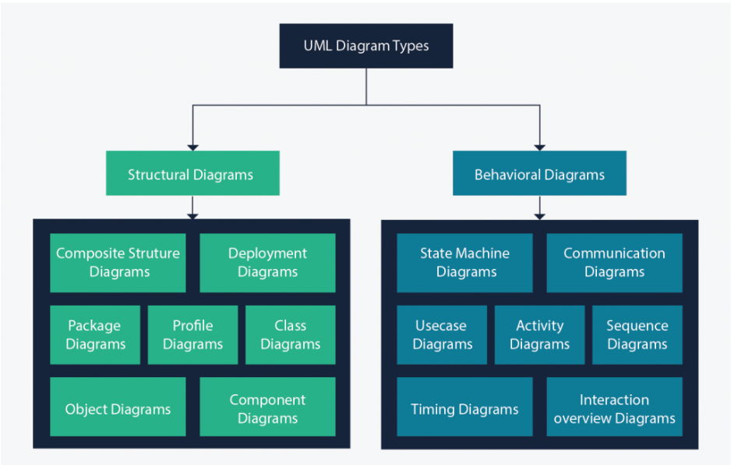

Slide 19
Structural Diagrams
Purpose:
Represent the static aspects of the system, focusing on the organization and structure of the system components.
Focus:
Elements such as classes, objects, and their relationships.
Usage:
Used to model the static structure of the system, defining the entities and their connections.

Slide 20
Behavioral Diagrams
Purpose:
Represent the dynamic aspects of the system, focusing on the behavior and interactions among the system components.
Focus:
Processes, interactions, and state changes.
Usage:
Used to model the functionality and behavior of the system over time.

Slide 21
Summary of Differences:
Static vs. Dynamic:
Structural diagrams focus on the static structure of the system, while behavioral diagrams focus on the dynamic behavior.
Elements vs. Interactions:
Structural diagrams describe the elements and their relationships, whereas behavioral diagrams describe how these elements interact and change over time.
Organization vs. Functionality:
Structural diagrams help in understanding the organization and arrangement of the system, while behavioral diagrams help in understanding the functionality and workflows.

Slide 22
This distinction between structural and behavioral diagrams helps in using UML effectively for different purposes in the software development lifecycle.
It also makes sure that both the structure and behavior of the system are well-documented and understood.

Slide 23
A
Structural Diagrams
They describe the static aspects of the system.

Slide 24
Class Diagram
Class diagrams are the main building block of any object-oriented solution.
They show the classes in a system, attributes, and operations / methods of each class and the relationship between the classes.
In most modeling tools, a class has three parts:
Name at the top,
attributes in the middle and
operations or methods at the bottom.

Slide 25
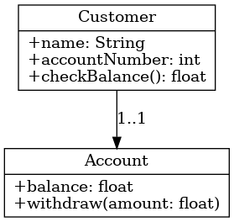
Example:
In a Library System, a Book class may have attributes like title, author, and methods like borrow(), return().
Another example in a graphical form:

Slide 26
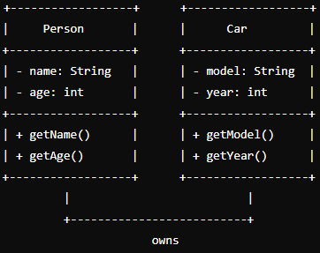

Slide 27
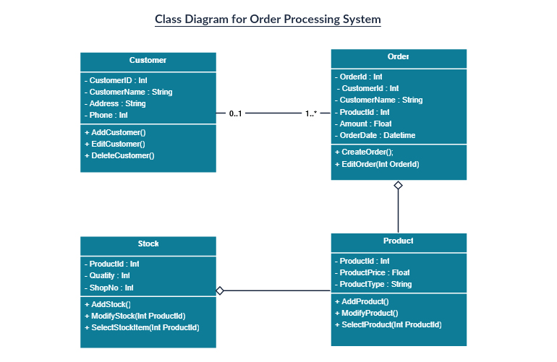

Slide 28
2. Object Diagram
Object Diagrams, sometimes referred to as Instance diagrams are very similar to class diagrams.
Like class diagrams, they also show the relationship between objects.
Represents instances of classes (objects) and their relationships at a particular moment in time.
In other words, they show what a system will look like at a given time: showing a snapshot or a photo taken at a specific time.
Because there is data available in the objects, they are used to explain complex relationships between objects.

Slide 29
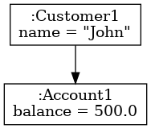
Example:
An object of class Book named book1 with current values assigned.
Another example in a graphical form:

Slide 30
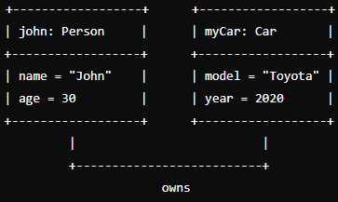

Slide 31
3. Component Diagram
A component diagram shows the high-level structure of a system, focusing on how the system is divided into components and how those components interact through interfaces.
It focuses on software components that are used in the system implementation stages.
It describes the organization and dependencies among software components.
These are mostly used when working with complex systems with many components.

Slide 32
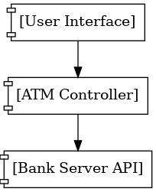
Components communicate with each other using interfaces.
Example:
User Interface, Database Access Layer, and Business Logic as separate components.
Another example in a graphical form:

Slide 33
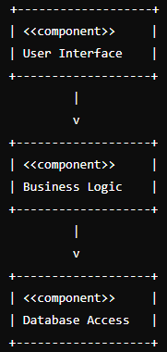

Slide 34
4. Deployment Diagram
A deployment diagram models the physical deployment of software artifacts (e.g., executables, libraries, databases) on hardware nodes (e.g., servers, devices).
It tells us what hardware components exist and what software components run or deployed on them.
Deployment diagrams are useful when your software solution is deployed across multiple machines with each having a unique / different configuration.
It shows where and how the different parts of a software system physically reside and communicate in the real-world environment.

Slide 35
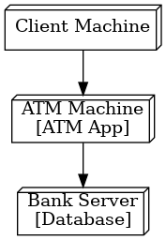
Associated elements includes nodes and communication paths.
Example: Web server and database server configuration.
Another example in a graphical form:

Slide 36
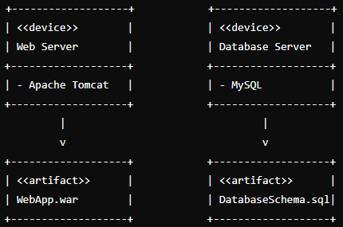

Slide 37
5. Package Diagram
A Package Diagram is a structural diagram that shows how a system is organized into packages or modules and how these packages depend on or relate to each other.
Related elements (such as classes, interfaces, or other packages) are organized into meaningful groups that simplifies complex models and making the resulting structure easy to understand.
Package diagrams organize large systems into manageable parts that also show dependencies between different parts/modules of the system.
Package diagrams can use packages containing use cases to illustrate the functionality of a software system.

Slide 38
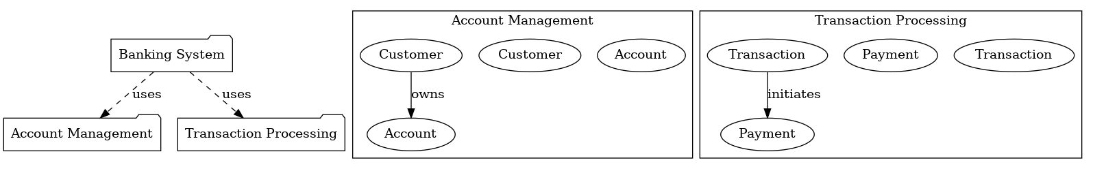
Package diagrams can also use packages that represent the different layers of a software system to illustrate the layered architecture of a software system.
Example:
A BankingApp package containing Accounts, Loans, and Transactions packages.
Another example in graphic format:
It Illustrates the grouping of related classes under "Account Management" and "Transaction Processing" within the overall "Banking System" package.

Slide 39
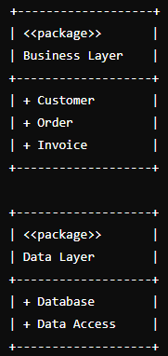

Slide 40
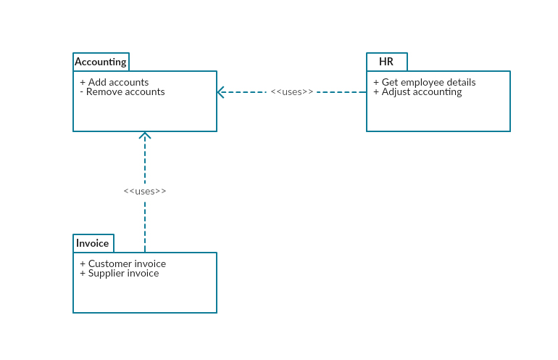

Slide 41
6. Composite Structure Diagram
A Composite Structure Diagram is a UML structural diagram that shows the internal structure of a class, including its parts (properties), ports (interaction points), and connectors between those parts.
It models the internal composition of a class or component.
A composite structure diagram describes how a class or component is composed of other elements, and how they interact at runtime to fulfill the behavior defined by the class.
Composite Structure Diagrams are often used in embedded systems and software modeling with parts.

Slide 42
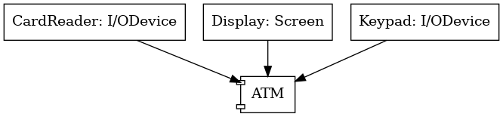
A composite structure diagram represents relationship between parts and their configuration which determine how the classifier (class, a component, or a deployment node) behaves.
An example is that of a Car class which may be composed of An Engine, A Transmission, A Dashboard, and Communication ports.
The Composite Structure Diagram for this class shows how these parts are wired together and how they interact with each other.
Another example in graphical format:

Slide 43
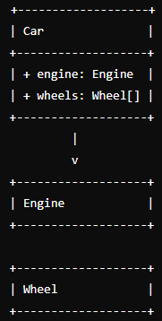

Slide 44
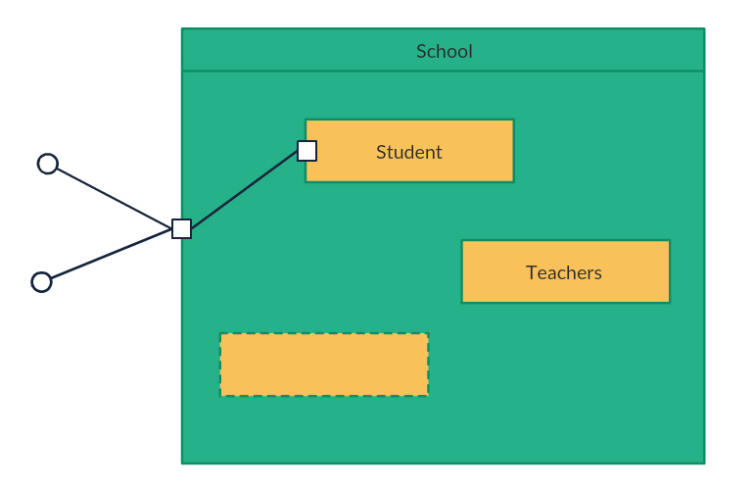

Slide 45
Profile Diagram
Profile diagram is a new diagram type introduced in UML 2. It is a diagram type that is very rarely used in any specification.
A Profile Diagram is a UML diagram used to customize UML for specific domains or platforms by defining profiles, which consist of stereotypes, tagged values, and constraints.
It allows modelers to extend UML's standard notation without changing its core, making it adaptable for specific industries, technologies, or methodologies.
A Profile Diagram does not replace UML’s existing diagrams – Instead, it modifies or enhances them, resulting into a diagram that will properly reflect a specific domain / field such as banking, aerospace, etc.

Slide 46
A Profile Diagram adds extra meaning through stereotypes, tagged values, and constraints, so the diagrams better reflect a specific field or domain.
Stereotype: An extension mechanism to create new types of modeling elements based on existing UML elements.
Tagged Value: An attribute associated with a stereotype that provides additional information.
Constraint: A condition or restriction that must be met by the elements extended by a stereotype.

Slide 47
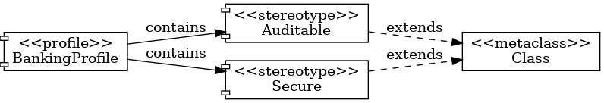
Example: You define a stereotype <<Auditable>> that applies to any class which needs audit logging.
Another example in graphic format:
It shows a BankingProfile with custom stereotypes (Auditable and Secure) extending the UML Class metaclass.

Slide 48
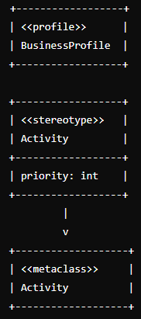

Slide 49
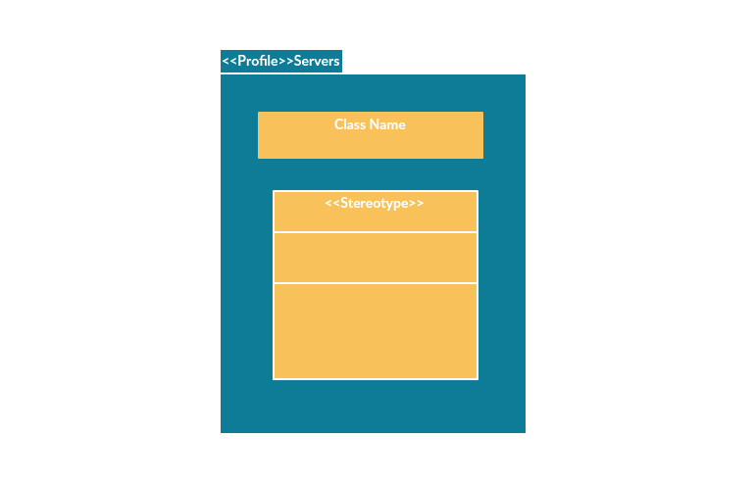

Slide 50
B
Behavioral Diagrams
These represent the dynamic aspects of a system (what it does).

Slide 51
1. Use Case Diagram
As the most known diagram type of the behavioral UML types, Use case diagrams give a graphic overview of:
the actors (external agents) involved in a system,
different functions needed by those actors, and
how these different functions interact with each other and with actors.
It’s a great starting point for any project discussion because you can easily identify the main actors involved and the main processes of the system.

Slide 52
A use case diagram gives us a high-level view of what the system or a part of the system does without going into implementation details.
It is basically a diagram representing different scenarios where the system can be used.
A Use Case diagram represents the functionality of a system from a user's perspective.
In other words, it describes the high-level view of a system’s functional requirements from a user’s perspective.
Associated elements includes actors and associations.

Slide 53
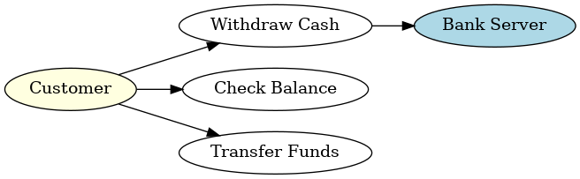
Example: Use Case Diagram for ATM System
Actors: Customer, Bank Server
Use Cases: Withdraw Cash, Check Balance, Transfer Funds
Customer → Withdraw Cash
Customer → Check Balance
Customer → Transfer Funds
Withdraw Cash → Bank Server
(Draw a simple diagram using this interaction)

Slide 54
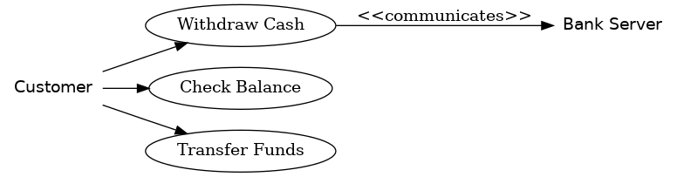
Example: Use Case Diagram for ATM System
Actors: Customer, Bank Server
Use Cases: Withdraw Cash, Check Balance, Transfer Funds
Customer → Withdraw Cash
Customer → Check Balance
Customer → Transfer Funds
Withdraw Cash → Bank Server
(Draw a simple diagram using this interaction)

Slide 55
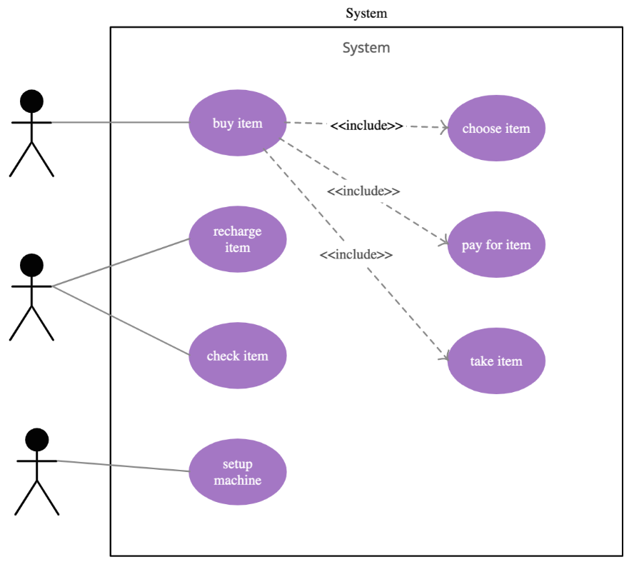

Slide 56
2. Sequence Diagram
Sequence diagrams in UML show how objects / components interact with each other and the order in which those interactions occur.
They show the sequence of calls, returns, and events for a specific functionality or scenario, in the system.
Sequence diagrams describe how and in what order the objects in a system function.
It’s important to note that they show the interactions for a particular scenario.
The processes are represented vertically, and interactions are shown as arrows.
Associated elements include lifelines, messages, and activation bars.

Slide 57
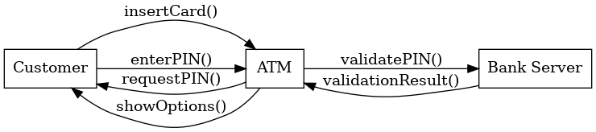
Examples:
Customer → ATM → Bank Server
(for a Withdraw Cash operation).
User logs in → System validates → System loads dashboard
(shown as messages between User, Login Service, and Database).
Another example in graphical format:

Slide 58
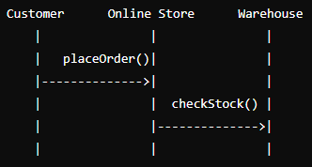

Slide 59
3. Activity Diagram
Activity diagrams represent workflow of a system. It models the flow of activities or business processes.
They can be used to describe the business workflow or the operational workflow of any component in a system.
They focuses on what happens next, rather than who performs them. It is about “What steps happen in this process?”
Activity Diagram models the flow of activities within a system. It represents workflows of stepwise activities and actions.
The flow or steps involved may be sequential or concurrent. It also provides for conditions, loops, forks, joins.

Slide 60
Sometimes activity diagram examples are used as an alternative to State machine diagrams.
Associated elements include activities, transitions, decisions, start and end nodes.
Example:
User login workflow: Enter → Validate → Grant/Deny Access.
Customer places order → System checks stock → If in stock, ship order; else, notify customer.
Another example in graphical format:

Slide 61
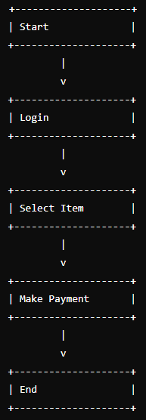

Slide 62
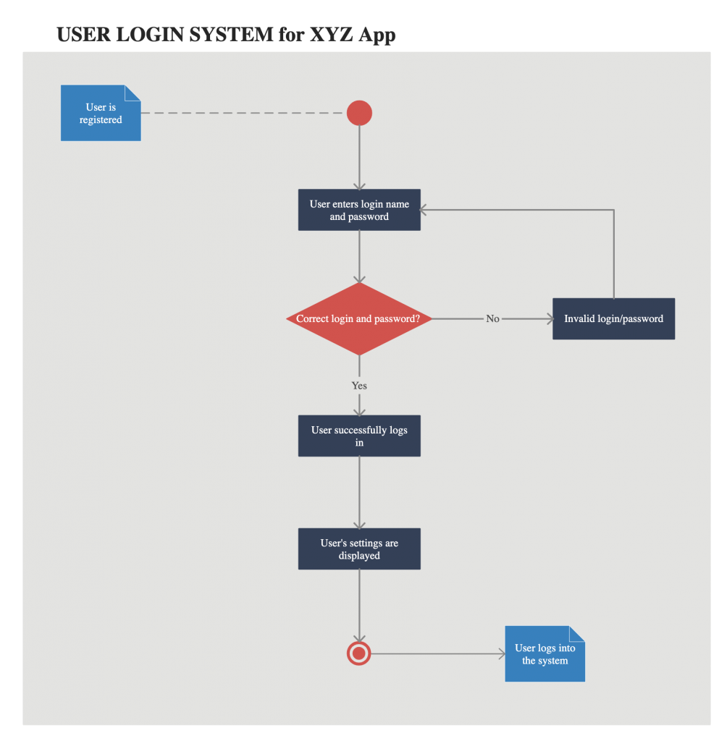


Slide 63
4. State machine diagrams
State machine diagrams are similar to activity diagrams, although notations and usage may be different.
They are sometimes known as State Chart Diagrams or simply State Diagrams.
A State Machine diagram represents / shows the different states an object or system can be in, and how it transitions from one state to another in response to events.
These diagrams are used to describe the behavior of systems that act differently according to the state they are in at the moment.
They are used to model the dynamic behavior of a system in response to time and changing internal / external factors. How an object changes states in response to events.

Slide 64
A state machine diagram focuses on the life cycle of a single object, showing:
States it can be in
Events that trigger changes
Transitions between states
They are also used in embedded or real-time systems.
Associated elements includes states, transitions, and events.
Example: States of a Traffic Light - Green → Yellow → Red.
Another example in graphical format:

Slide 65
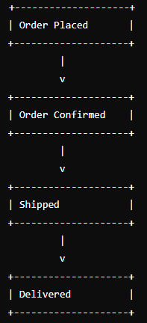

Slide 66
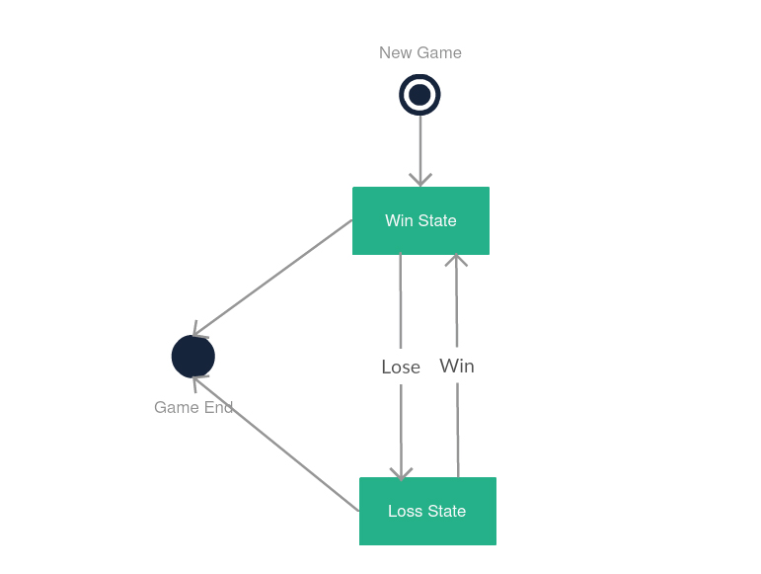

Slide 67
5. Communication Diagram
In UML 1 they were called collaboration diagrams.
Communication diagrams are similar to sequence diagrams where the emphasis is on time flow of messages.
In contrast, communication diagram emphasizes on links and relationships among participants. It focusses on how objects interact with each other through messages.
The focus is on the structural relationships between the objects rather than just the time order of events.
The same information can be represented using a sequence diagram and different objects.

Slide 68
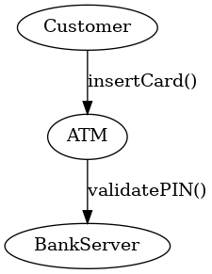
Example: Objects involved in Send Email operation with message flow between them.
Another example in graphic format:

Slide 69
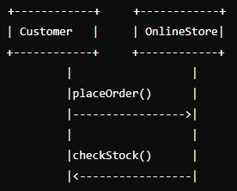

Slide 70
6. Timing Diagram
Timing diagrams are very similar to sequence diagrams.
They represent / show the behavior (changes in state or condition) of objects in a given time frame.
Timing diagrams show time and duration constraints which govern changes in states and behavior of objects.
Compare and contrast this with State Machine Diagrams which are used to describe (or to show) the behavior of systems that act differently according to the state they are regardless of the duration of time that has passed.

Slide 71
If it is only one object, the Timing Diagram is straight forward.
If there is more than one object that is involved, a Timing Diagram can also used to show interactions between objects during that time frame.
Associated elements include lifelines, state or condition changes, and time axis.
Example: Object states over time during file upload.
Another example in graphical format:

Slide 72
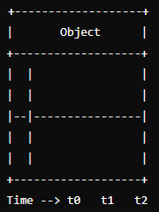

Slide 73
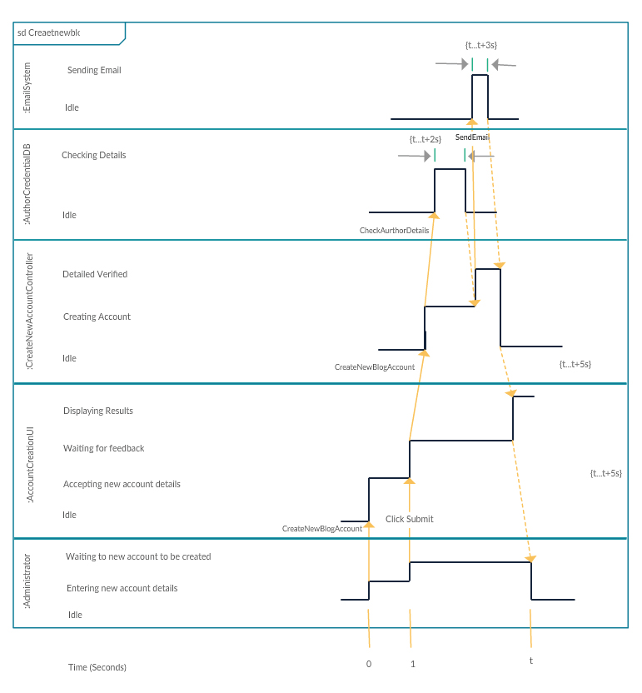

Slide 74
7. Interaction Overview Diagram
Interaction overview diagrams are very similar to activity diagrams.
While activity diagrams show a sequence of processes, Interaction overview diagrams show a sequence of interaction diagrams.
Interaction Overview Diagram combines elements of activity and sequence diagrams.
They are a collection of interaction diagrams and the order they happen. They provide an overview of the control flow within a system.
Interaction Overview diagrams may also be said to be combining aspects of activity and sequence diagrams to show control flow overview of the system.
They helps to simplify complex interactions into simpler occurrences.

Slide 75
Example:
Overview of interactions in an online order system.
Another example in graphic format:

Slide 76
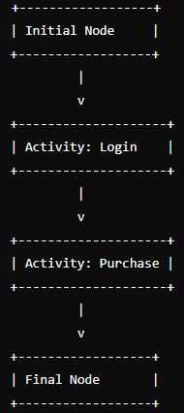

Slide 77
Evolution of UML

Slide 78
1. UML 1.x Series (1997-2001)
UML 1.0 (1997): The first version of UML was released by the Object Management Group (OMG). It was a unification of the methods of Grady Booch, James Rumbaugh, and Ivar Jacobson, known as the "three amigos.“
UML 1.1 (1997): Introduced shortly after UML 1.0 with some refinements and additional diagrams.
UML 1.2 (1998): Included further refinements and clarifications.
UML 1.3 (1999): Focused on clarifying the semantics and improving the consistency of the language.

Slide 79
UML 1.4 (2001): Added action semantics for describing the details of operations.
UML 1.5 (2003): Introduced minor improvements and corrections, including the addition of activity diagrams as a distinct diagram type.
UML 2.x Series (2003-present)
UML 2.0 (2005): A major revision that introduced significant changes and additions.
UML 2.1 (2007): Included further refinements and corrections.

Slide 80
UML 2.2 (2009): Improved precision and clarity of the specifications, with updates to existing diagrams and better definitions.
UML 2.3 (2010): Included minor improvements and clarifications.
UML 2.4 (2011): Focused on aligning UML with the latest meta-object facility (MOF) standards.
UML 2.5 (2015): Major update that streamlined and simplified the specification. The superstructure and infrastructure were combined into a single specification document.
UML 2.5.1 (2017): A minor revision to fix issues and clarify ambiguities found in UML 2.5.

Slide 81
3. UML 2.6 and beyond
While there have been discussions and plans for further versions, UML 2.5.1 remains the latest officially released version by the OMG, reflecting the cumulative improvements made over two decades.
Efforts continue to maintain and improve the standard, focusing on better integration with other modeling standards and addressing feedback from the modeling community.

Slide 82
Creating UML Diagrams

Slide 83
Guidelines:
Start with a clear understanding of the system requirements.
Use appropriate diagrams to represent different aspects of the system.
Keep diagrams simple and focused.
Use consistent notation and naming conventions.

Slide 84
Common Tools used for UML Modeling
Lucidchart: A web-based tool with advanced features
Draw.io: A free, web-based diagramming tool
StarUML: A desktop-based tool
Visual Paradigm: A comprehensive design tool
Enterprise Architect: A robust tool for UML Modeling
IBM Rational Rose: Desktop legacy tool
Microsoft Visio: A Microsoft Product

Slide 85
The tools above are software applications (or web-based platforms) specifically designed to help you create, edit, and manage UML diagrams like class diagrams, sequence diagrams, use case diagrams, etc.
They often include extra features such as code generation, reverse engineering, and collaboration.
Some are web-based and require no installation – you just open them in your browser:
Lucidchart
Draw.io (also called diagrams.net)
Others are desktop applications – you need to install, similar to installing Word or Excel:

Slide 86
StarUML
Visual Paradigm
Enterprise Architect
IBM Rational Rose (classic desktop tool, now older but still used in some organizations)
Special Note on IBM Rational Rose
It is one of the older but historically important UML modeling tools.
It is Windows-based, requires installation, and was widely used in the 1990s–2000s for both UML diagrams and software design documentation.
Nowadays, it has largely been replaced by newer tools, but some organizations still use it for legacy projects.

Slide 87
Tool | Type | Installation Required? | Free / Paid
Lucidchart | Web-based | No | Paid (free trial)
Draw.io (diagrams.net) | Web-based / Desktop | Optional (Desktop app available) | Free
StarUML | Desktop (Windows, macOS, Linux) | Yes | Paid (low cost)
Visual Paradigm | Web-based / Desktop | Optional | Paid (Community Edition free)
Enterprise Architect | Desktop (Windows, with Linux/macOS via Wine) | Yes | Paid
IBM Rational Rose | Desktop (Windows) | Yes | Paid (legacy product)

Slide 88
QUESTIONS

Slide 89

END
THANK YOU !

